Slide 1
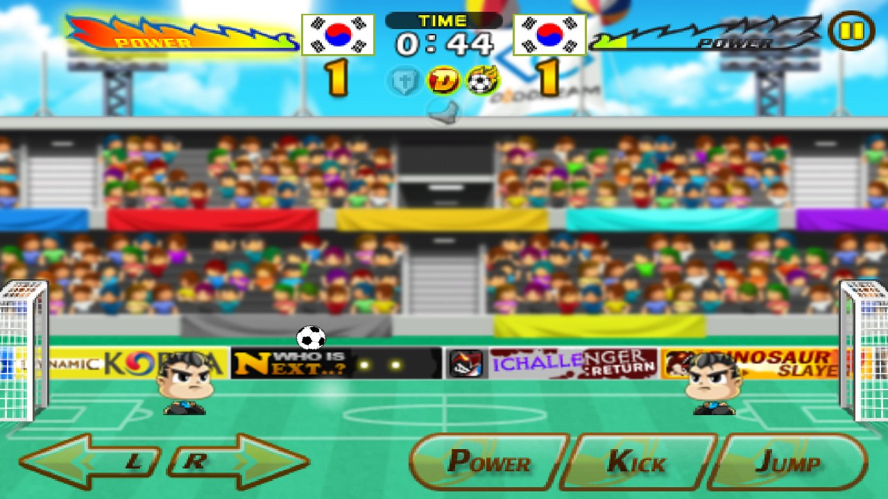
Final Project CS:Video Game Head Soccer
By:Sebastian Emilio Moscoso Riveros

Slide 2
Introduction
The first part in the project was ,chosen the type of video game that I want . So I chose Head Soccer , because I love play soccer.The second part was , chosen the part of graphics to development the video game and the design pattern ;I chosen openGL because it has the perfect toolkit to develop my video game , and my design pattern is Mediator Design Pattern.

Slide 3
Learning Part
This was the part most important to develop the game,that was learned openGL , because it have the toolkit to do my game, so for me , is important that in the learning process the person develop the game with the basic knowledge , that is gain every time that proof some new.

Slide 4
1.Library linker
2.Create a Windows
3.Shaders
4.Textures
5.Transformations

Slide 5
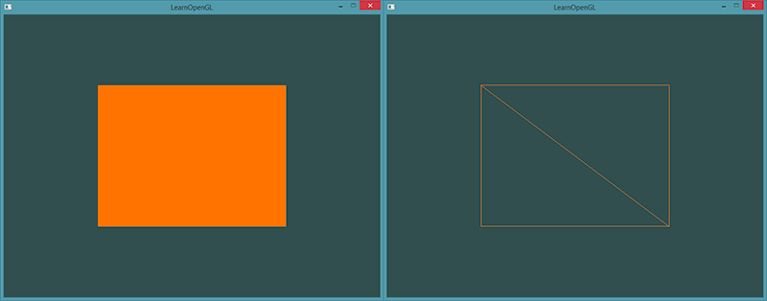
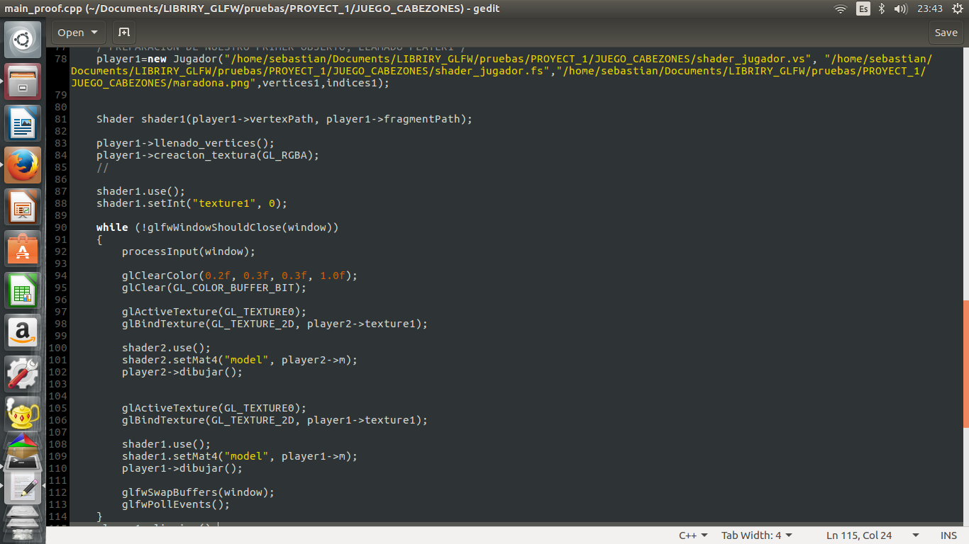
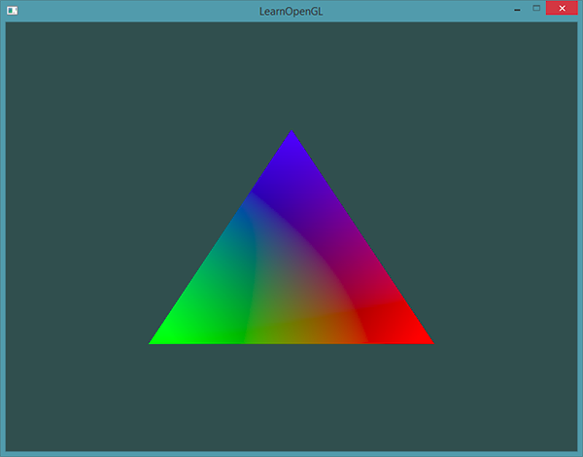

Slide 6
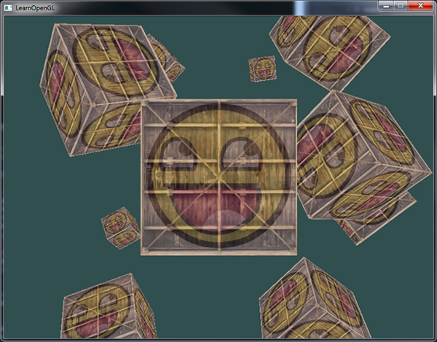
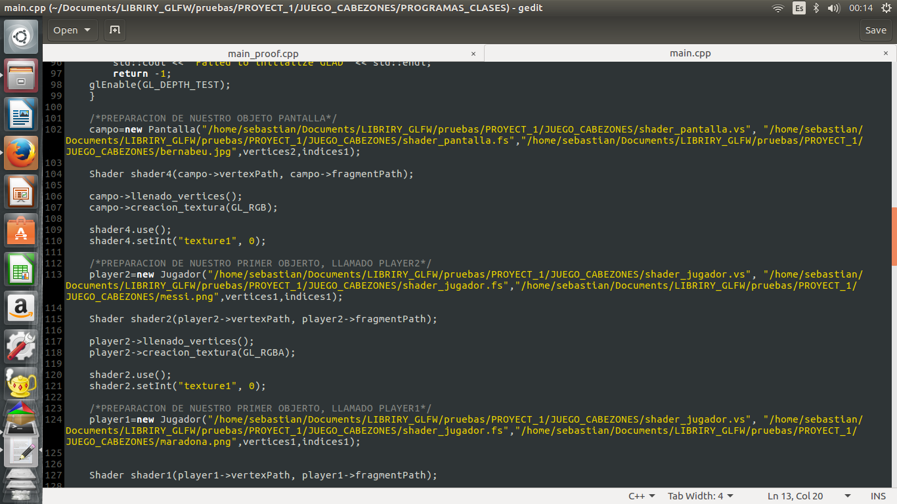
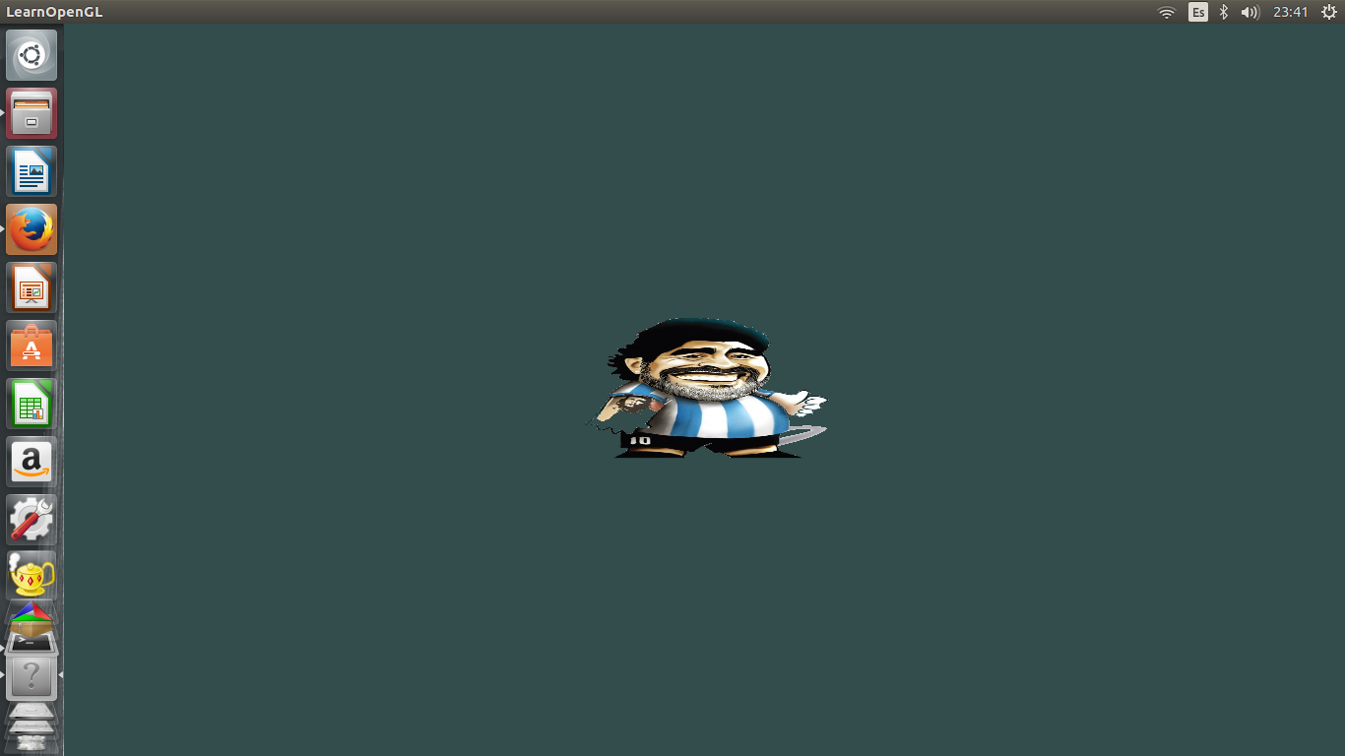

Slide 7
Advanced Process
The part of my project that I advanced is the creating of all the objects in scene ,and the move of my objects players.That move is :
FORWARD()
BACKWARD()
JUMP()

Slide 8
The structure of my advanced here is :
main.cpp
CLASS CARGAR
CLASS SHADER
CLASS JUGADOR
CLASS PELOTA
CLASS PANTALLA
jugador.cpp
jugador.h
shader_jugador.vs
shader._jugador.fs
pelota.cpp
pelota.h
shader_pelota.vs
shader._pelota.fs
pantalla.cpp
pantalla.h
shader_pantalla.vs
shader._pantalla.fs

Slide 9
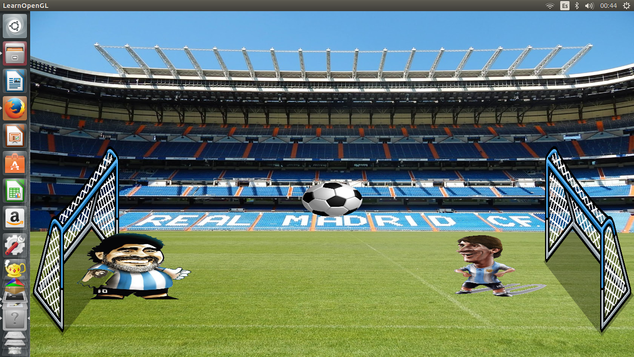
The object that I have:
1.PLAYER1
2.PLAYER2
3.PELOTA
4.ARCO1
5.ARCO2
6.PANTALLA

Slide 10
the part that i will complete to my final game
1.Implement the collisions.
2.Implement the fisic of the ball.
3.Put the duration of the game and the score, in the up screen part.
4.Create a system that store the information of the results.
5.Do the pattern design pattern in my game,I decided to change of command to Mediator Design Pattern.

Slide 11
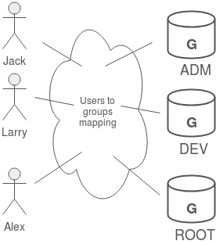
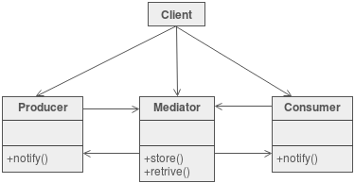
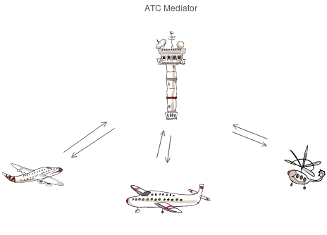
Why mediator Design Pattern

